Slide 1
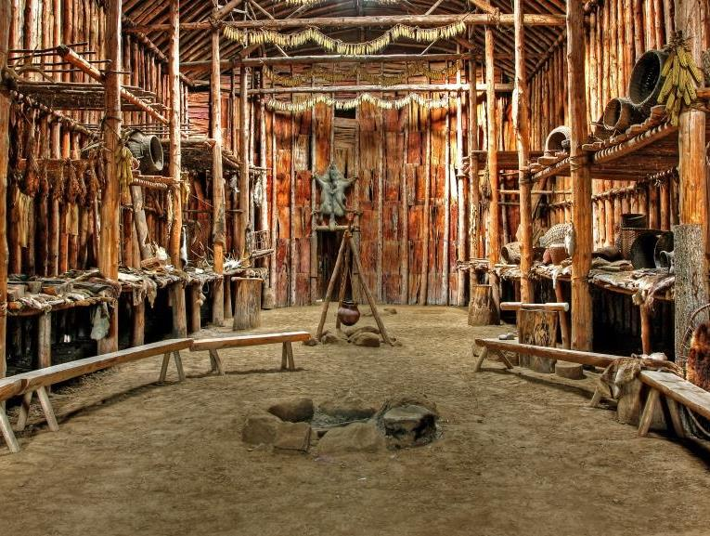
Beyond the Prophecies
Kahontakwas Diane Longboat

Slide 2
Bringing Greetings

Slide 4
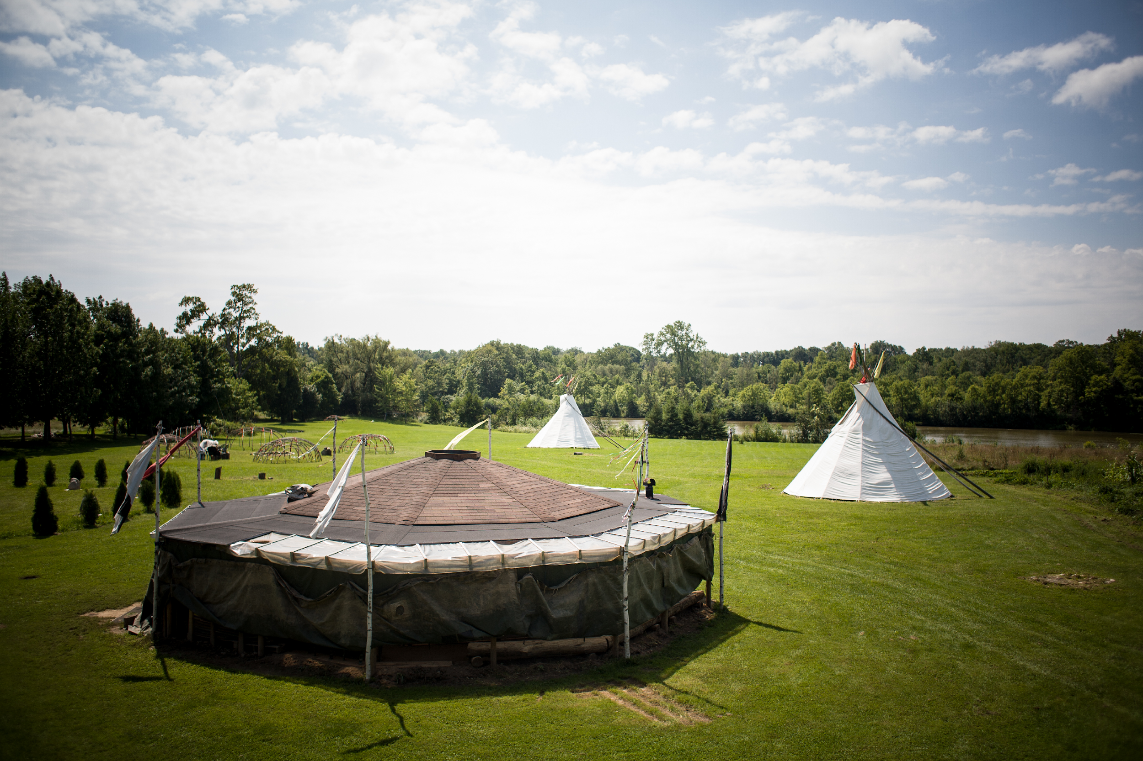

Slide 6
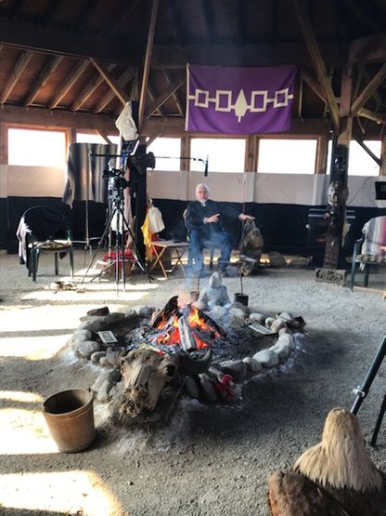

Slide 7
How will We Apply the Sacred Guidance
that We Have Been Provided in Our
Prophecies and in Sacred Communication
with the Spirit in Order to Secure
the Future for the next Seven Generations?

Slide 8
WARNINGS OF PROPHECY
“MOTHER EARTH WILL BE SICK”
Water Levels Rise Floods; Scarcity of Fresh Water
Rivers Will Flow in the Opposite Direction Glaciers Melt
The Rivers Will Burn Chemicals, Black Water
The Fish Will Die in the Water Warm Water, Poisons
Trees Will Die from Top Down Acid Rain, Foreign Fungus and Insect Infestations
Animals Will Be Born Deformed Glyphosate
Huge Stone Monsters Will Tear Open the Face of the Earth Tar Sands
The Air Will Burn The Eyes and Lungs Volcanic Eruptions, Smoke From Burning Forests
The Birds Will Fall From the Sky Extinction, Changes in the Magnetic Field of the Earth
Strange Diseases Will Appear Neurological, Genetic, Plagues
Animals Will Disappear Extinction of Species
Notes:
1700’s Kaiwiio, “The Good Message”

Slide 9
LIVING SPIRIT
SPIRIT OR LIFE FORCE OF CREATION
“Mother Earth is Alive” Living spirit of the land and in our non-human family, pattern of life force on the land connects all life on Earth to all of the Universe, one heartbeat, one light. One infinite light comprised of the Creator’s Love for all Beings in creation.
SPIRIT OF THE LAND
First Law contains reciprocal duties for maintaining balance in the world; principles, laws and ceremonies maintain the balance of the natural world; patterns of interdependence for sustaining all life beings, held in the commons for the benefit of all.
SPIRIT OF THE HUMAN BEING
Ethics of Care-Relationship, reciprocity defined in codes of conduct for maintaining peace, creating a thriving, cooperative society grounded in love and reciprocity; Individual rights, relationships are paramount combined with a collective responsibility for interdependence and co-existence for the good of all.

Slide 10
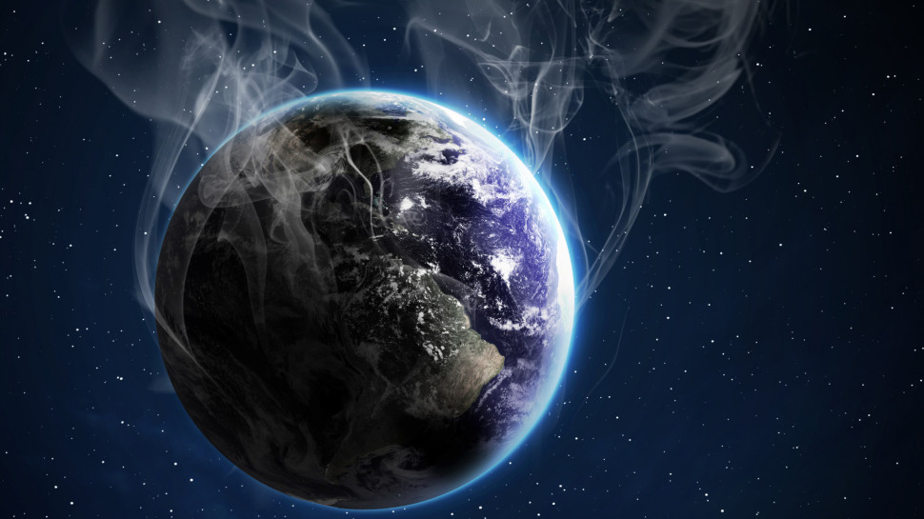
Notes:
White light of Spirit covers all celestial and earth beings

Slide 11
FIRST LAWS ARE NATURAL LAWS
“Mother Earth is Chief, Human Beings are Her Servants”
Life Force in All Living Beings in Creation, Interdependent, Related, Equal, Pattern of Life in Each One.
Laws were given by the Creator to Human Beings to Guide Human Nature and are Sacred, Perfect in Nature, Infallible, Indestructible, Infinite Lifespan.
CONTINUANCE OF LIFE ON MOTHER EARTH DEPENDS ON FOLLOWING THESE LAWS:
Reciprocal relationships with Mother Earth; She sustains us and we give back our love and respect in ceremonies, follow protocols of protecting Her Indigenous Wisdom Traditions-Political Protocols, Boundaries of Land, Giving Thanks, Songs, Dances, Ceremonies to Honour First Law.

Slide 13
FIRST LAW, SACRED LAWS, SOURCE LAWS
Original Knowledge Given by the Spirit Throughout Time
Embedded in the Creation Story, Thanksgiving Address, Four Sacred Ceremonies, Great Law of Peace, Kariwiio (Good Message) Prophecies, Annual Cycle of Ceremonies, language, wampum belts
Includes Knowledge Acquired from the Spirit in Ceremonies, Dreams, Messages, as Continuous Prophecy Unfolding Daily
Full Meaning is Found within Indigenous languages, and Sacred Records of Wampum Belts, Condolence Cane
Held within Societies Responsible for the Knowledge

Slide 14
HUMAN MADE LAWS
Human Made Laws replaced First Law
Human Made Laws do not account for the Sacred Relationship with the Life Force on the Land
Not heeding First Law means you live outside the Natural Law
Ego Planet, Profound Greed
Pandemics, Climate Crisis, Wars, Famine, Political Upheaval, Economic Collapse, Extinction, Exploitation, based on Greed of Human Nature
First Law of Indigenous Knowledge systems inspires a “Remembering”
Journey that All Peoples of the Earth have Received this Law

Slide 15
COLONIALISM AT THE HEART OF GLOBAL CRISIS
Destruction of Indigenous Lands, Extraction of Resources, Genocide of Indigenous Peoples, by Multi-National Corporations and Supported by a World Wide Market Economy
Trans-National Corporations Control Production, Distribution, and Consumption, Accountable to No Government
Control the Economic Life of the People by Creating Dependency on Energy and Food Production
Political Interests are Tied to the Economic Interests of the Corporations
War becomes the Economic Engine to Corporations for the Billions to be Made From War

Slide 16
OUR CHALLENGE
A Global Shift in Human Consciousness for the Healing of Mother Earth and the Spiritual Evolution of Humanity
“Our Survival Depends on a Change in Human Values”
~Oren Lyons, Faith Keeper, Onondaga Nation
Placing the Values of First Law in a Pragmatic Form that Will Inform A Change in How Society Functions

Slide 17
KANIKONHRI : YOHTSHERA
| I : YO |
Good Traits We Value, Good Mind, Empathy, Kindness, Generosity, Caring, Respect, Love
| KA |
All Things are Created in This Manner
| NIKONHR |
Life Force of Creation, Spiritual Intelligence that We Share with all Beings in Creation-Water, Winds, Plant Life, Animal Life, Water Beings, Flying Beings
| HTSHERA |
A State of Being

Slide 18
KA’NIKONHRIYOHTSHERA
A natural Human Being with a Good Mind, Sharing a Consciousness of Relationship to all Beings in Creation Equitably, Inclusive, Embracing the Richness of Diversity.
Power, Reason, Ethical Decision Making for the Good of All, Leads to Peace.

Slide 19
PRINCIPLES
RIGHT THINKING MIND
Placing our Minds in Alignment with Natural Laws of Mother Earth and Spiritual Laws of the Creator
No Privilege, Superiority, Class System, No Wealth Held By A Few
Creator Placed Gifts Here in Abundance for All and Belong to All Equally, with Remembrance of Giving Thanks Daily
Nothing Belongs to Human Beings, Not Even Their Capacities, Skills
Understanding that Humans Do Not Own the Earth, It Belongs to the Creator

Slide 20
PRINCIPLES
REASON
Gift of a Good Mind to Reason and to Make Decisions Without war
Healthy Minds Desire Peace
Use All Means to Mediate, Hold Council, Reach Consensus
Train the Mind to Reason for the Good of All to Ensure No One’s Rights are Abused, Neglected
Maintain Justice Equitably for All
Earth has Abundance Not Scarcity

Slide 21
PRINCIPLES
POWER
Mind of Reason and Ethics are in Alignment with First Law and Spiritual Laws
Peace is the Outcome
Unity of Purpose
Achieved through Personal Healing and Education, Creating a Spark in the Souls of the People to Believe and Act Accordingly
Spirituality is the Highest Form of Political Consciousness ~John Mohawk
Spiritually Conscious Society Uses its Ability to Reason to Maintain a Healthy Society

Slide 22
HAUDENOSAUNEE PRINCIPLES
GAHSKYAONYOH
Empowerment
GANOKWASRA
Deep, Unconditional Caring for Self and Others
GENDAO
Compassion, Understanding of Others
GASAHTSRA
Strength Within Oneself, Self Reflection, Balance, Embodying the Teachings of the “Good Mind”
AWEHAODE
Using a Soft Voice and Kind Words When Speaking

Slide 23
LIBERATION TECHNOLOGIES
REVITALIZING LOCAL COMMUNITY BASED CULTURES
GOAL. Independence from Governments and Multinational Corporations
Our Culture is Communal, Ceremonies are Celebrated in Community
Clan based Kinship Systems, Relatives across territories in Canada/US and throughout the Global Indigenous Community
Nations sit in Governance, Laws, Codes, Principles of Moral Justice
Our Homelands-Gardens, Waters, Medicines, Wild Foods
One People, Earth is the Floor, Sky is the Roof
Ethics Guide the Reformation of Human Nature to Create a Global Coalition of Hope for Young People who Inherit the Future

Slide 24
LIBERATION TECHNOLOGIES
REVITALIZING LOCAL COMMUNITY BASED CULTURES
“
“
Pity the Generation that Allows Destruction on Mother Earth they will know Unspeakable Suffering”
~Kariwiio
Mother Earth is Chief, We are Her servants, She is Not a Commodity
Apply this Knowledge to a New Economy, New Governance, New Health System, New Education, New Lifestyles

Slide 25
MEN’S
WHEEL

Slide 26
WOMEN’S
WHEEL

Slide 27
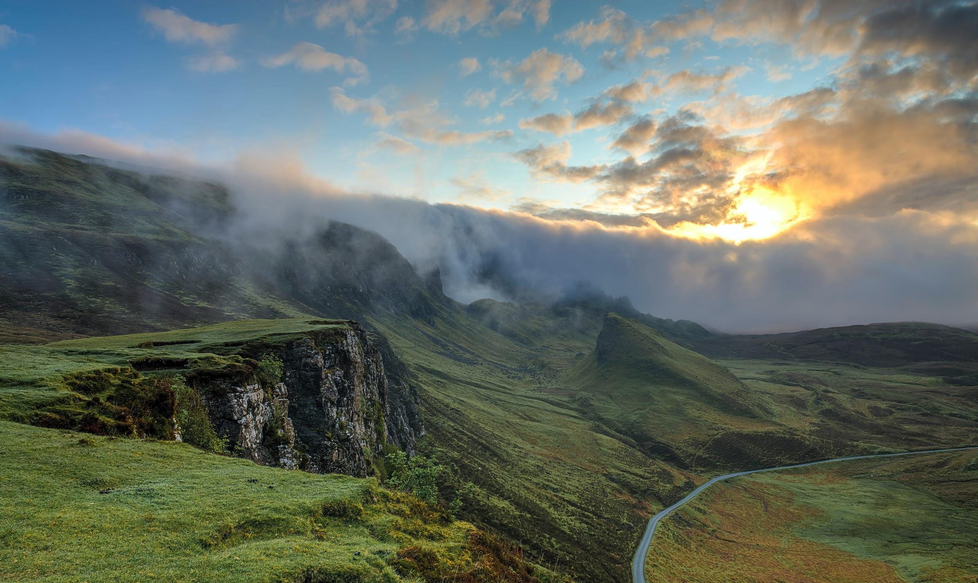
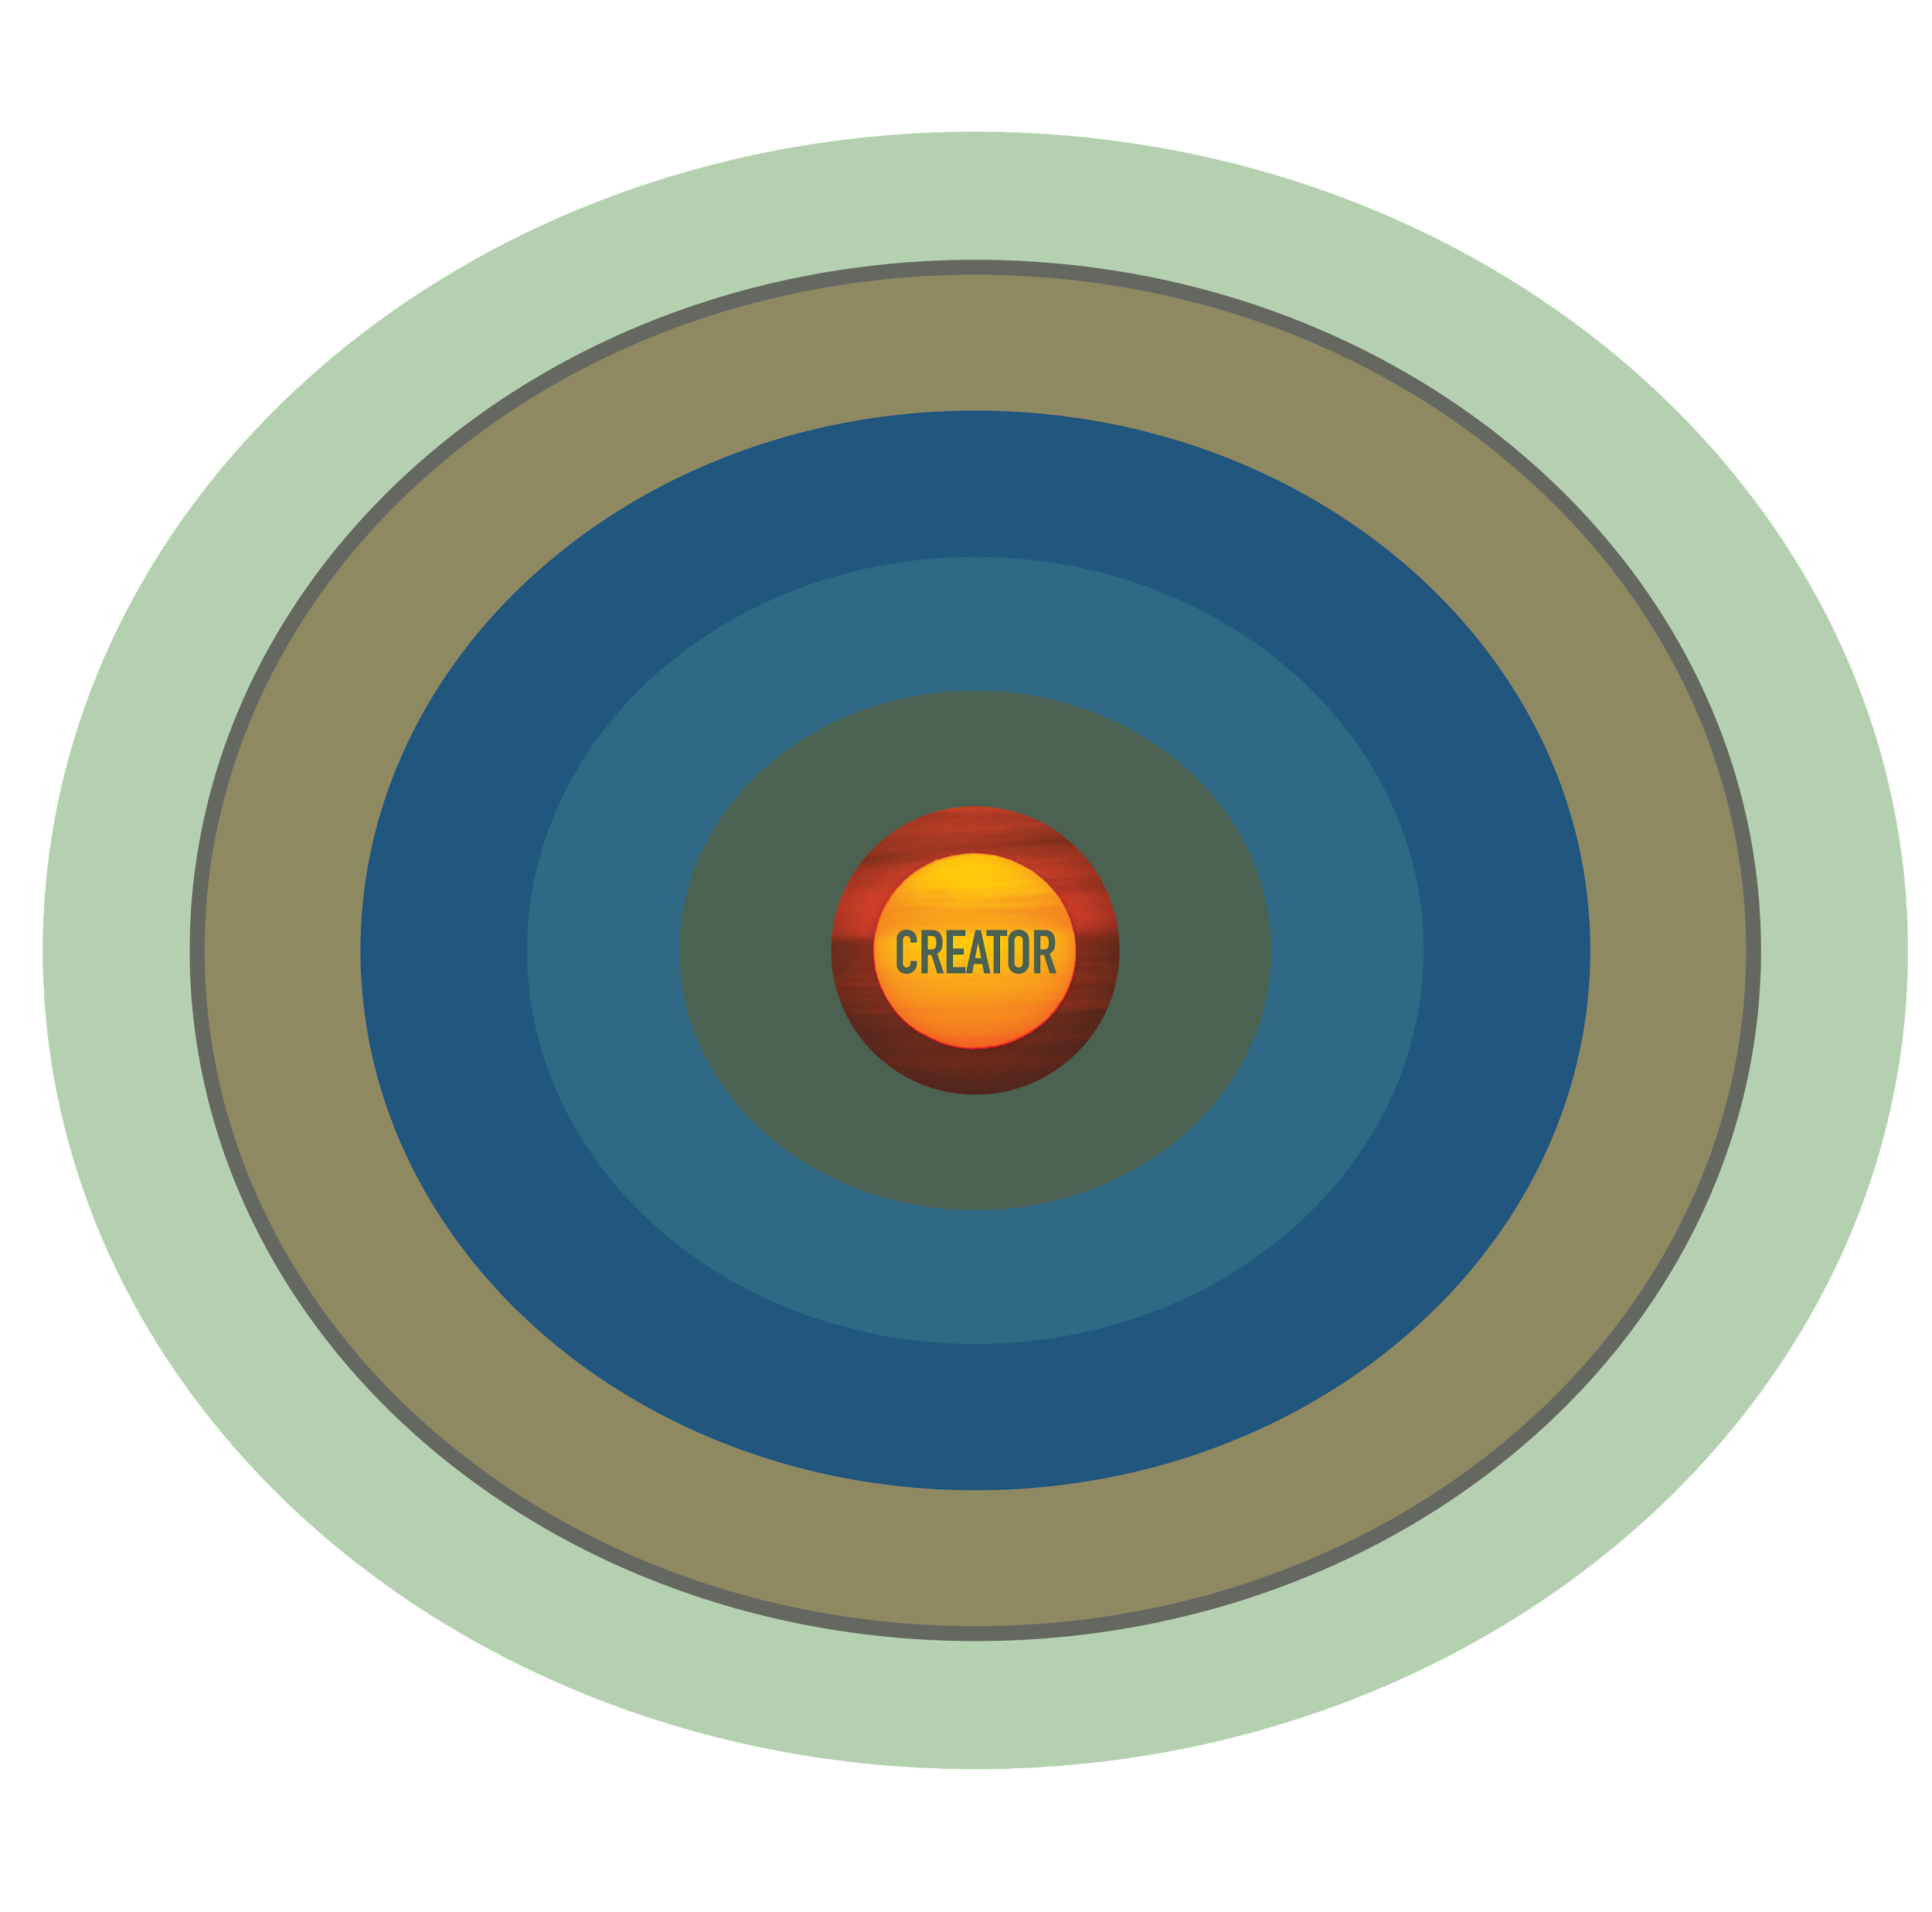
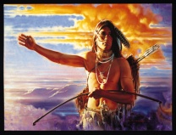
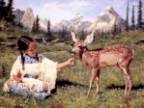
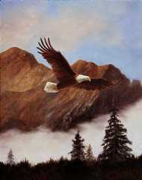
THE
NATURAL
ORDER
of
HUMANITY
EARTH
CHILDREN
WOMEN
ELDERS
MEN

Slide 28
100 Years of Influence of Our Ancestors ON YOU TODAY
Great Grandparents
Grandparents
Parents
You

Slide 29
MULTIPLE INTELLIGENCE
| COGNITIVE |
Language, Neural Pathways
| PHYSICAL |
Spirit of the Body, Care for Self
| SPIRITUAL |
Activate Spiritual DNA, Soul Pathways
| EMOTIONAL |
Socialization, Heart Pathways

Slide 30
100 Years of Your Influence FROM TODAY AND FORWARD
Great Grandchildren
Grandchildren
Children
You

Slide 31
OUR COMMON FUTURE
Health of the Planet Depends on the Health of Land-Based Indigenous Cultures All Over the World and the Continuance of their Knowledge of the Land, Waters, Life Sustaining Patterns of Living on the Land, Giving Gratitude through Ceremonies, Healing the Land, Air and Waters.
Future of Humanity Depends on Learning from These Ancient and Original Cultures.

Slide 32
LIFE PRINCIPLES COMMON TO INDIGENOUS PEOPLES WORLDWIDE
First Law Supports Life Systems of the Planet through the Lense of Indigenous Knowledge Systems, Rooted Globally through Shared Value Systems
Moral Compass to Support the Growth and Emergence of One’s Highest Self
Values, Principles that Define what it is to be a
Human Being
Ancient Wisdom Empowers Human Nature to Evolve
Ethics of Care for Human Family and Care for the Earth

Slide 33
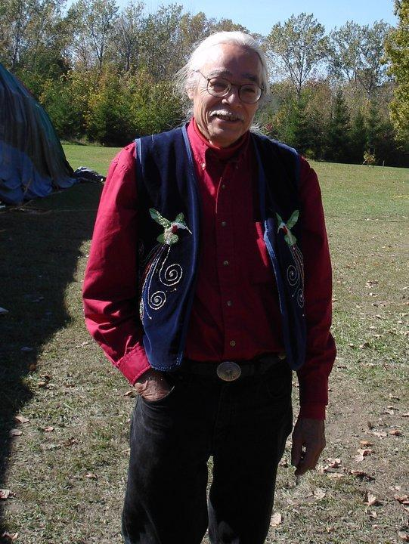
SPIRITUAL LEADER
ONAUBINISAY
Guiding us through these transformative times are messages from our beloved Spiritual Leaders, reminding us of who we are, our personal spiritual mandates to fulfill the Law of Life for all Beings in creation.
Jim challenges us to develop an Institute for the Study of the Spirit, another pragmatic way to support the unfolding of the prophecies and their active application to social, political and environmental changes.
Onaubinisay (Jim Dumont) who shines with such a bright light that all darkness disappears.
(Parliament of the World’s Religions, Keynote Address to 10,000 global delegates, 2018)
https://www.youtube.com/watch?v=AB-Fi31klTs
Photo Credit: Thunderbird Partnership Foundation

Slide 34
THE SACRED DAY IS UPON US
We are Living in the Era of the Spiritual Springtime
No Challenge can Withstand the Fulfillment of Our Prayers and Prophecies. The Sacred Day Reveals Corruption and Injustice
Peace Will Prevail
You are Here to Fulfill the Dream of the Creator to Cultivate a Higher Spiritual Consciousness in Yourself
Caring for Self and Others is Rooted in Our Cultures, Languages, Histories, Spirituality and in Traditional Knowledge Systems
The Dawn is Ours
~Amanda Gorman, Jan. 20,2021

